Slide 1
Sleeping Teaching Assistant
Group Members:
Rabia
Zainab-Binte-Hassan

Slide 2
What is sleeping Teaching Assistant?
Any university department has a teaching assistant (TA) who helps undergraduate students with their programming assignments during regular office hours.

Slide 3
How it can be implemented?
This project deals with solving the Sleeping Teaching Assistant problem using thread synchronization. The implementation involves defining approaches to be taken for different scenarios as to how a Teaching Assistant (TA) and students interact with each other. The solution will be implemented using POSIX threads, mutex-locks, and semaphores for the different scenarios.

Slide 4
Some definitions to understand our project:
POSIX Threads; usually referred to as pthreads , is an execution model that exists independently from a language, as well as a parallel execution model. It allows a program to control multiple different flows of work that overlap in time.
Mutex-Lock; a mutex is locking mechanism used to synchronize access to a resource. Only one task (can be a thread or process based on OS abstraction) can acquire the mutex. It means there is ownership associated with mutex, and only the owner can release the lock (mutex).
Semaphore is a variable or abstract data type used to control access to a common resource by multiple processes in a concurrent system such as a multitasking operating system.

Slide 5
How our project works?
The project problems are solved by the team using POSIX threads, semaphores and a FIFO queue in order to describe the behaviors of the TA and the students. Both the TA and students will have their own semaphores and separate p-threads. By using a mutex-lock the situation of a deadlock can be avoided as either the TA or the student will have exclusive rights to change their state and this can be accomplished by only one person at a given instance. By using a First-In First-Out queue, starvation can be avoided as we know every student will be served according to the time they arrive at the TA’s office. Therefore, no student will be able to skip the line. The team approaches the Teaching Assistant Problem by solving 4 different scenarios.

Slide 6
Possible Scenarios of our project?
Scenario One
There will be zero students coming to visit the TA and the TA will check the hallway outside his office to see if there are any students seated and waiting for him. If there are none, the TA will sleep in his office.
Scenario Two
When a student arrives at the TA’s office and finds the TA sleeping. Then the student will awaken the TA and ask for help. When the TA assists the student, the student's semaphore changes from 0 to 1 and waits for the TA's semaphore. When the TA finishes helping one student, he will check if there is any other student waiting in the hallway. If yes, he will help the next student and if not, TA goes back to sleeping and TA's semaphore becomes 1 and awaits student's semaphore.
Scenario Three
When a student arrives while the TA is busy with another student. Then the student who arrived will have to check if the TA is busy. If the TA is busy, the student will have to wait seated outside in the hallway until the TA is done with his session. When the TA completes his session, the student seated outside will be called in by the TA for a review session. Once all students have finished their sessions and left the TA’s office, the TA will go back to sleep after making sure no students are waiting.
Scenario Four
When a student arrives while the TA is busy in a review session, and all the seats in the hallway are occupied. Then, student will have to leave the hallway and come back later. When the student comes back, eventually, and there is a seat available, he will take a seat and wait for his turn with the TA.

Slide 7
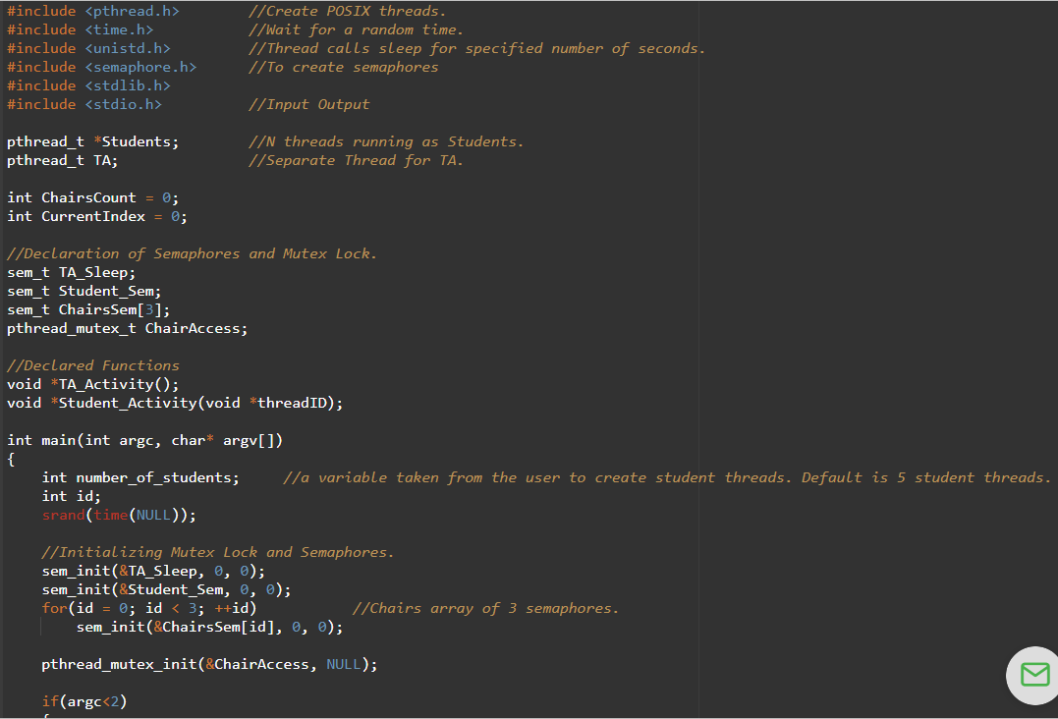
Code Hint:

Slide 8
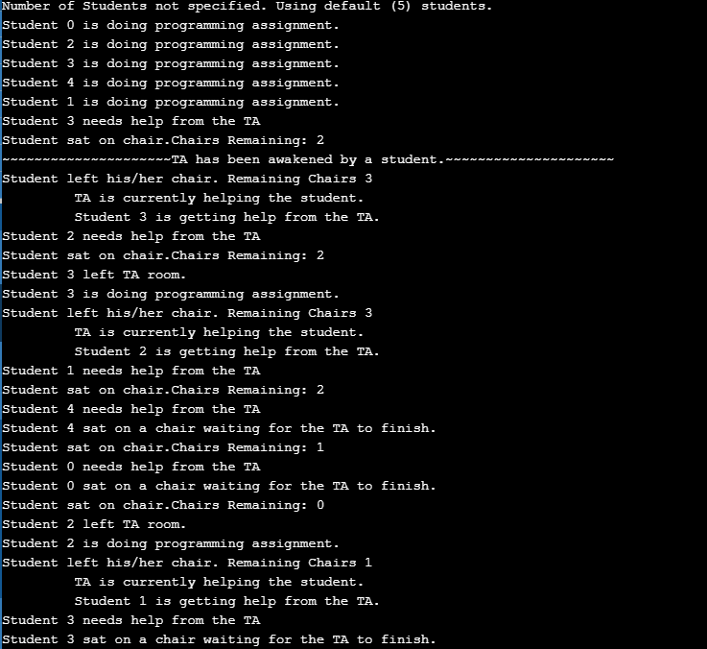
Code Output:

Slide 9
Reference Links:
https://github.com/shubhlpu16/Sleeping-Teaching-Assistant
https://www.chegg.com/homework-help/questions-and-answers/project-sleeping-teaching-assistant-university-computer-science-department-teaching-assist-q8730961

